Slide 1
Derivation for cluster size

Slide 2
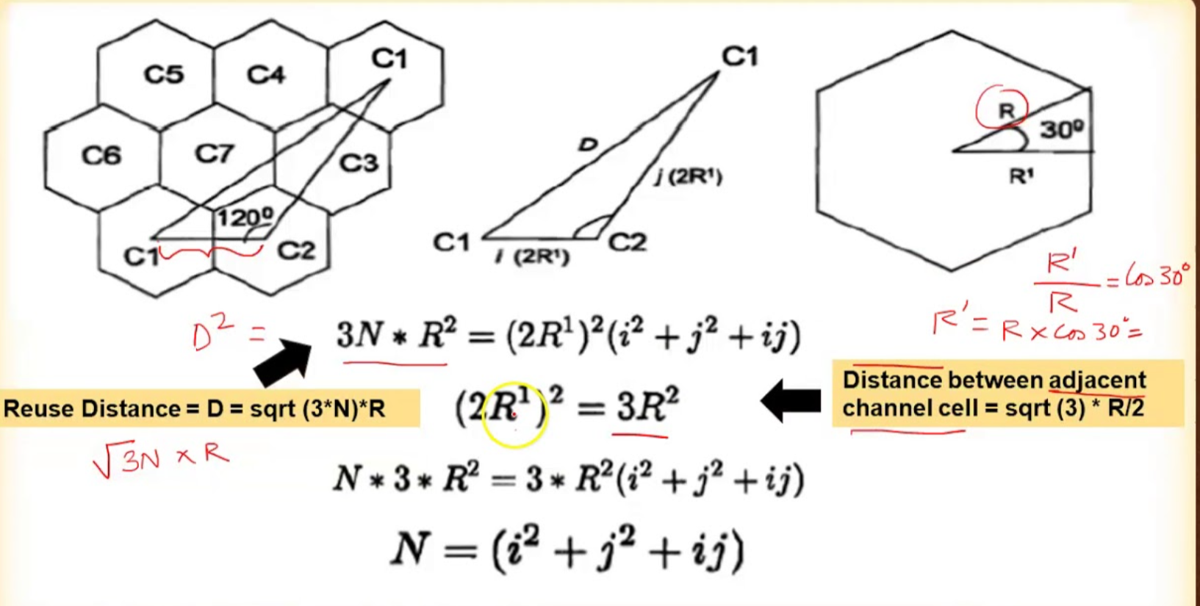

Slide 3
Derivation for co-channel reuse ratio

Slide 5
